Slide 1
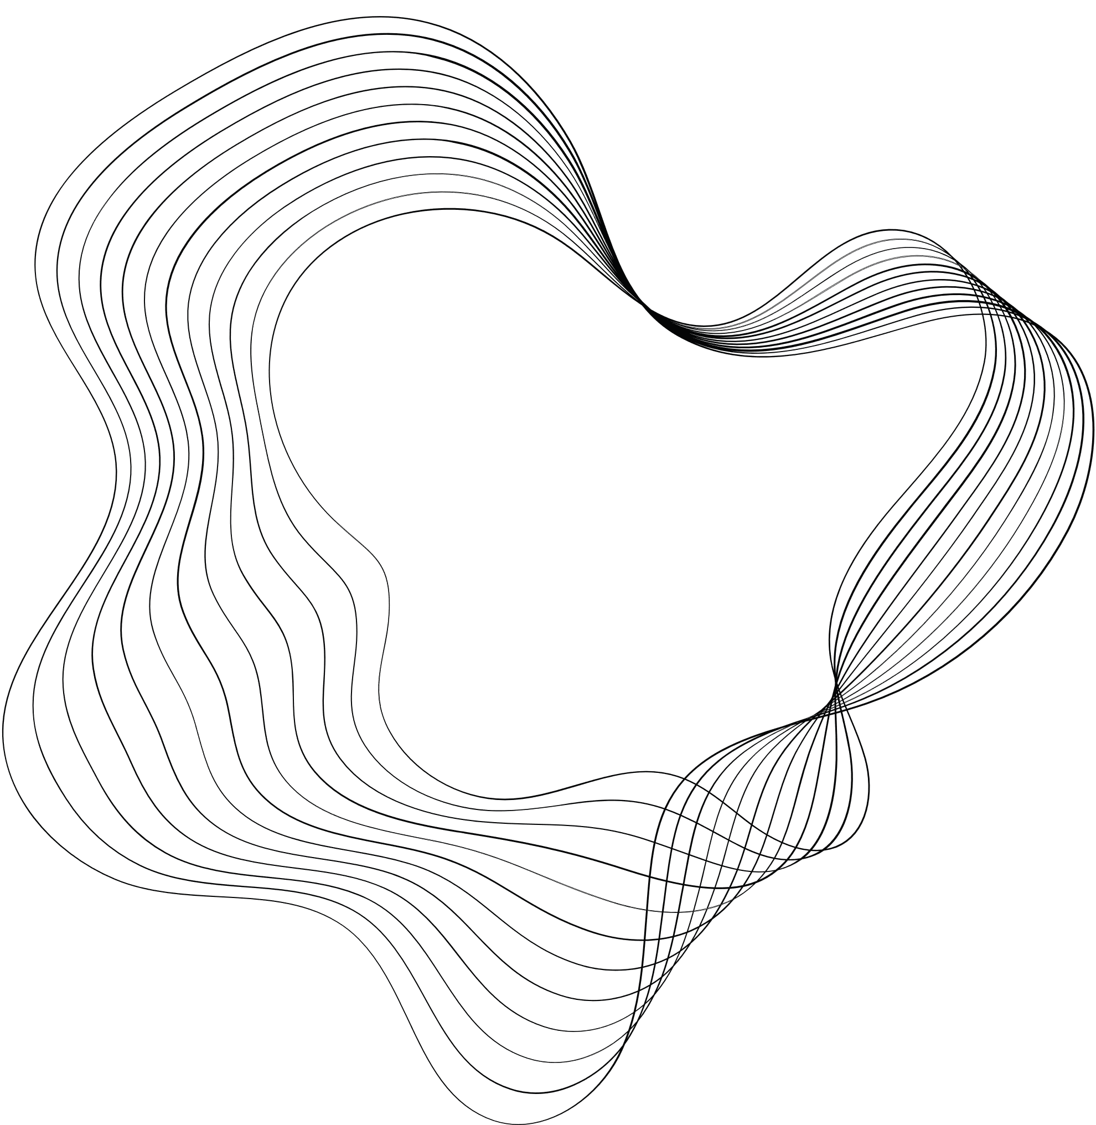

Department of Mathematics
Indian Institute of Technology Kharagpur
Masters Thesis Project 1
Privacy Enhanced Conversational AI Using Large Language Models
Submitted By: Keerti Panchakshari Charantimath 19MA20059
Guided By:
Professor Hari Shankar Mahato
Department of Mathematics
Indian Institute of Technology Kharagpur

Slide 2

Introduction
Large Language Models (LLMs) are AI models trained on massive text data using deep learning techniques like Transformers, equipped with billions of parameters. They learn language patterns from diverse sources and excel in various natural language processing tasks, from text generation and translation to summarization and question answering.
IPFS, or the InterPlanetary File System, is a decentralized protocol that distributes files across a network of nodes, eliminating the need for centralized servers. Each file is assigned a unique cryptographic hash, enabling efficient retrieval from the nearest or fastest node rather than a single server. This decentralized approach enhances data availability, resilience, and speeds, revolutionizing how we store and share data on the internet.

Slide 3
Motivation
Combining these two powerful technologies along with the security of encryption technology, we can achieve
Trust and Security
Streamlined Convenience
Expanded Potential
This can help us create the following technologies :
1
2
3
Chatbots to guide through ERP or Databases
Increasing the capabilities of voice-activated chatbots
Chatbots with tailored functionalities to provide financial advice
Notes:
1. **Trust and Security:** Integrating blockchain with chatbots ensures heightened security for online transactions, addressing concerns about privacy and trust in digital interactions.
2. **Streamlined Convenience:** By harnessing chatbot capabilities, tasks spanning multiple platforms or apps can be efficiently managed through simple text prompts, enhancing convenience and reducing inconvenience.
3. **Expanded Potential:** The fusion of blockchain's security and chatbot versatility could exponentially broaden the applications of chatbots, offering a seamless and trustworthy user experience across various functionalities.

Slide 4
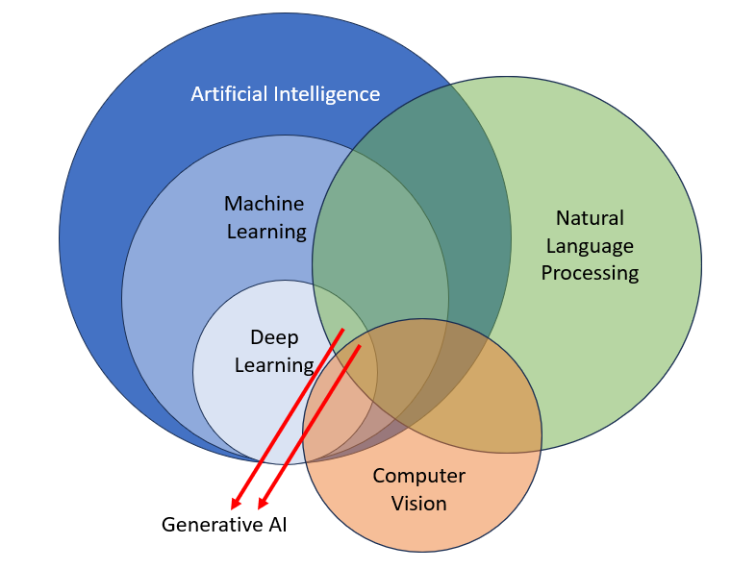
What Are Large Language Models?
LLMs, or Large Language Models, are sophisticated artificial intelligence models trained on vast amounts of text data. These models, such as GPT-3, utilize deep learning techniques like Transformers and possess billions of parameters, enabling them to understand, process, and generate human-like text across various natural language processing tasks.

Slide 5
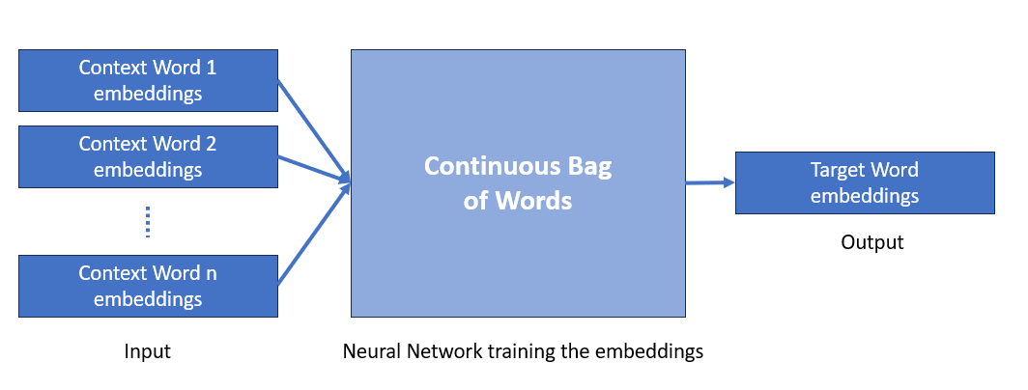
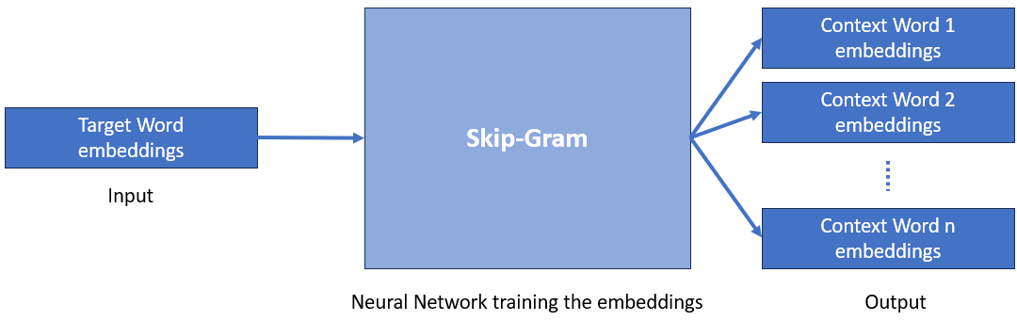
Word to Vector Encoding: Word2Vec
Word to Vector Encoding is a technique used in natural language processing (NLP) to convert words or phrases into numerical vectors. It’s based on the idea that words with similar meanings tend to occur in similar contexts within a large corpus of text.

Slide 6
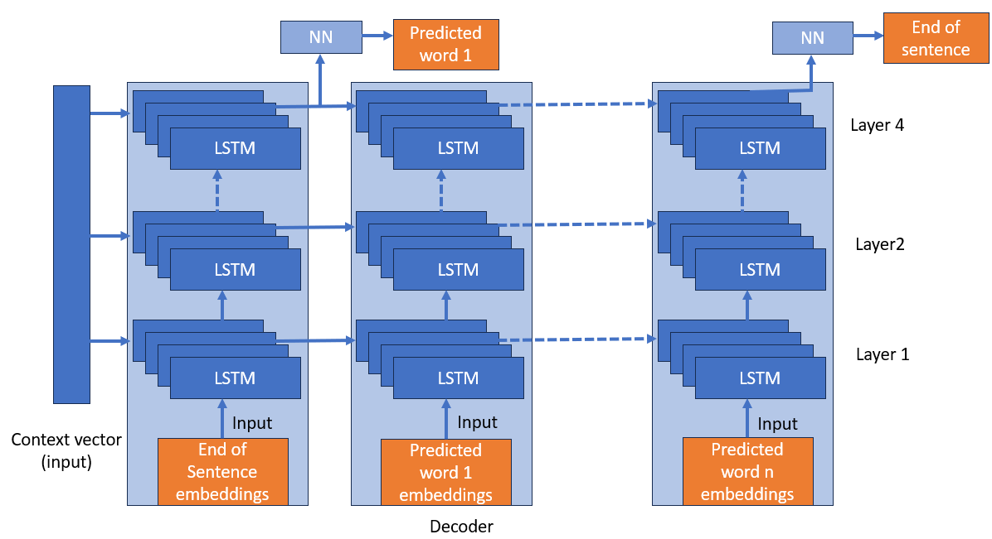
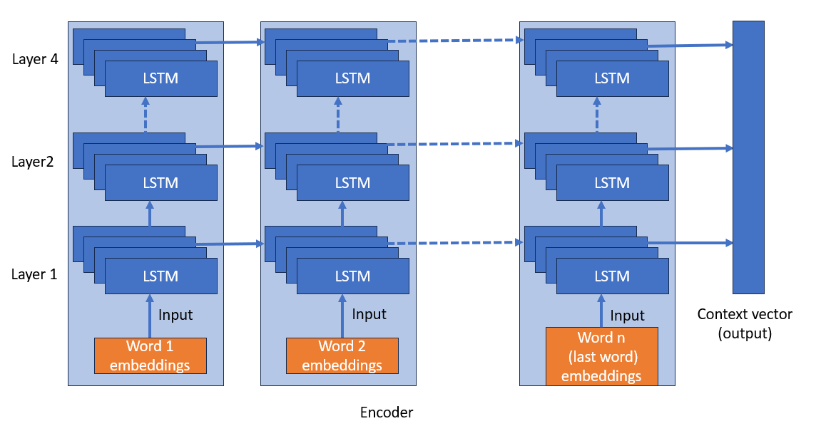
Sequence to Sequence Model: Seq2Seq
The Sequence-to-Sequence (Seq2Seq) model is a neural network design employed for sequence-related tasks like language translation, text summarization, and question answering. Comprising an encoder and a decoder, it's a fundamental architecture in natural language processing (NLP) that facilitates transforming sequences from one domain to another, allowing for effective handling of sequential data.

Slide 7
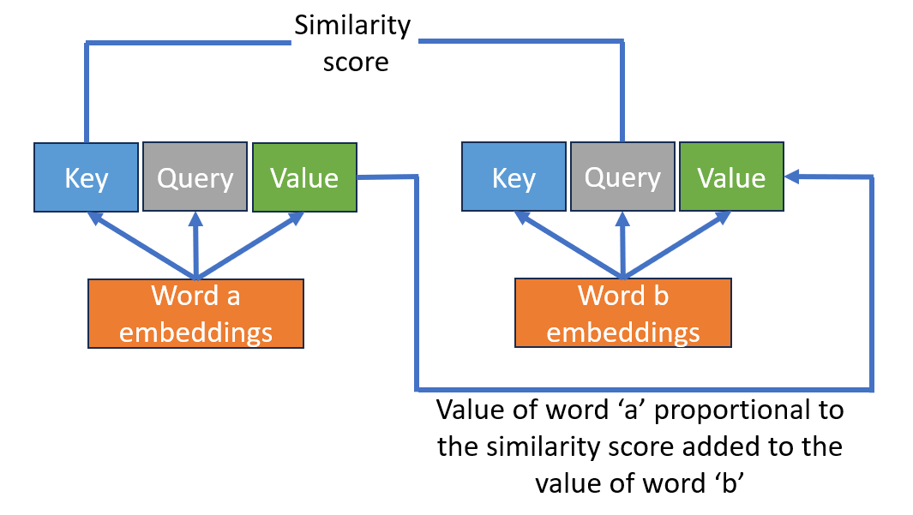
Attention
Attention enables the model to focus on specific parts of the input text while processing and generating output. It involves calculating attention scores, which are similarity scores between the word being processed and all the words that would potentially have an influence on it.

Slide 8
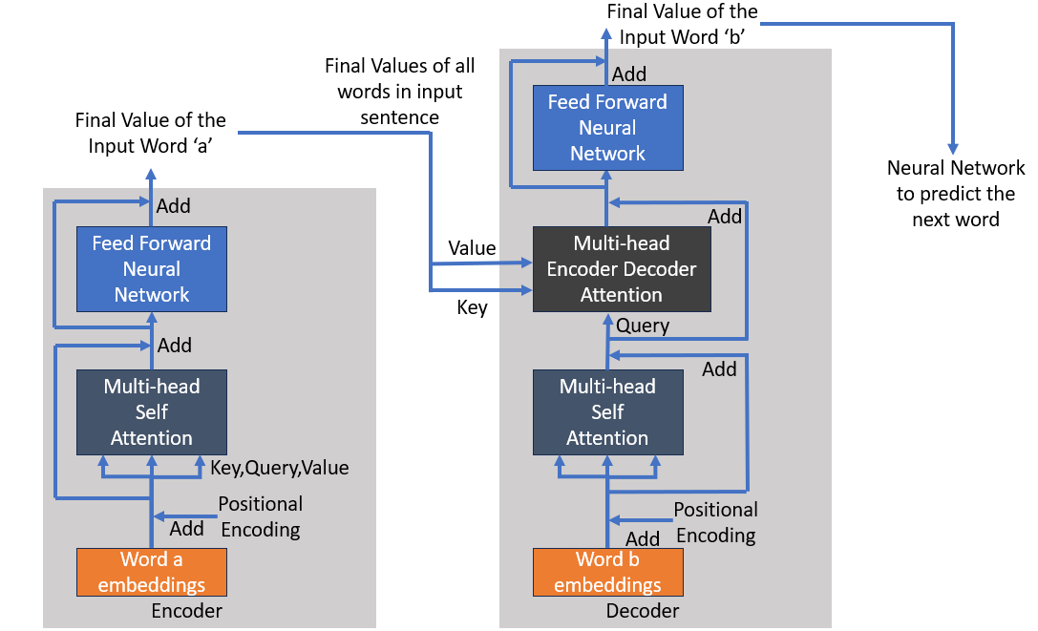
Transformer

Slide 9
Types of Transformers
1
2
3
Encoder-Decoder Transformers
- Text-to-Text Transfer Transformer
- BART - Bidirectional and Auto-Regressive Transformer
Encoder-only Transformers
- BERT - Bidirectional Encoder Representations from Transformers
Decoder-only Transformer
- Generative Pre-trained Transformer Series (GPT-3, GPT-2)
Notes:
1. **Trust and Security:** Integrating blockchain with chatbots ensures heightened security for online transactions, addressing concerns about privacy and trust in digital interactions.
2. **Streamlined Convenience:** By harnessing chatbot capabilities, tasks spanning multiple platforms or apps can be efficiently managed through simple text prompts, enhancing convenience and reducing inconvenience.
3. **Expanded Potential:** The fusion of blockchain's security and chatbot versatility could exponentially broaden the applications of chatbots, offering a seamless and trustworthy user experience across various functionalities.

Slide 10
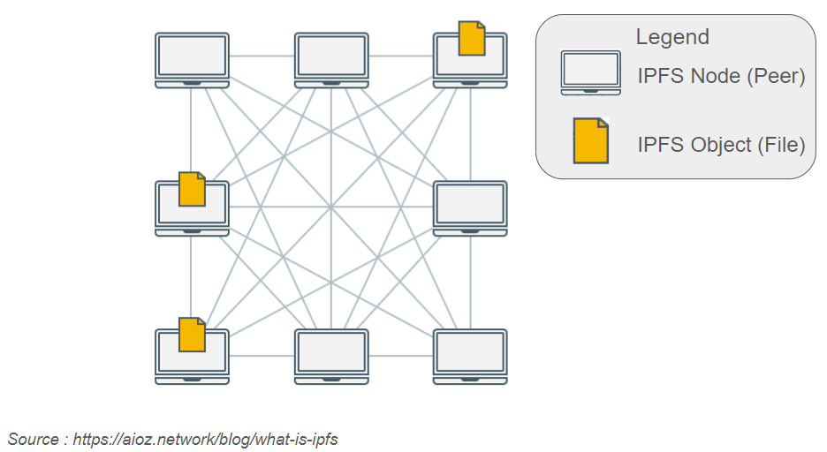
InterPlanetary File System
Features
- Follows Content Addressing
Uses Distributed Hash Table
Allows Versioning
Avoids Duplication
Uses Merkle DAG
Disadvantage
File stored in non-encrypted format on the peer devices
Solution
Symmetric key encryption algorithm

Slide 11
Implementation
Implementation of LLMs on local system
Aim: Run and interact with pre-trained Large Language Models (LLMs) on a local system, without the utilization of online LLM APIs is a secure and accessable manner
To achieve the same, these steps were followed :
Selecting a Pre-trained Model
Initializing the Model
Tokenization and Input Handling
Inference and Generation
Notes:
1. **Trust and Security:** Integrating blockchain with chatbots ensures heightened security for online transactions, addressing concerns about privacy and trust in digital interactions.
2. **Streamlined Convenience:** By harnessing chatbot capabilities, tasks spanning multiple platforms or apps can be efficiently managed through simple text prompts, enhancing convenience and reducing inconvenience.
3. **Expanded Potential:** The fusion of blockchain's security and chatbot versatility could exponentially broaden the applications of chatbots, offering a seamless and trustworthy user experience across various functionalities.

Slide 12
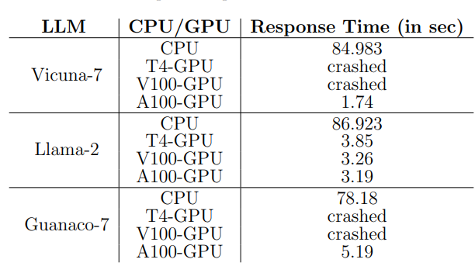

Implementation
Fine-tuning the LLM
Aim: Enabling LLM model to read, understand and answer questions based on custom personal files.
Step 1: Selection of an LLM Model
Has better contextual understanding
Fine-tuned to maximize performance specifically on conversational tasks.
Notes:
1. **Trust and Security:** Integrating blockchain with chatbots ensures heightened security for online transactions, addressing concerns about privacy and trust in digital interactions.
2. **Streamlined Convenience:** By harnessing chatbot capabilities, tasks spanning multiple platforms or apps can be efficiently managed through simple text prompts, enhancing convenience and reducing inconvenience.
3. **Expanded Potential:** The fusion of blockchain's security and chatbot versatility could exponentially broaden the applications of chatbots, offering a seamless and trustworthy user experience across various functionalities.

Slide 13
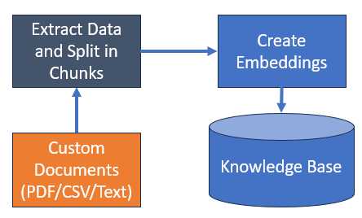
Implementation
Fine-tuning the LLM
Step 2: Ingestion of data from personal files
Used Chunking Strategy:
Recursive Chunking Chunk Size- 1000 Overlap Size- 20
Used Embedding Creation Algorithm:
Instructor Algorithm
Notes:
1. **Trust and Security:** Integrating blockchain with chatbots ensures heightened security for online transactions, addressing concerns about privacy and trust in digital interactions.
2. **Streamlined Convenience:** By harnessing chatbot capabilities, tasks spanning multiple platforms or apps can be efficiently managed through simple text prompts, enhancing convenience and reducing inconvenience.
3. **Expanded Potential:** The fusion of blockchain's security and chatbot versatility could exponentially broaden the applications of chatbots, offering a seamless and trustworthy user experience across various functionalities.

Slide 14
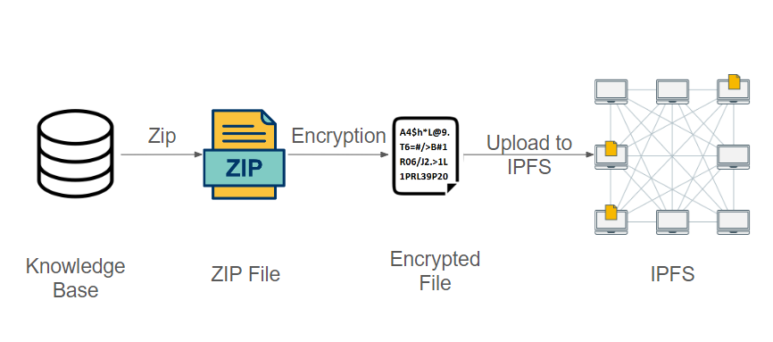
Implementation
Encryption and Uploading over IPFS
Aim: Fortifying the security of ingested data while making it accessible
Step 1: Selection of a symmetric key encryption algorithm
Advanced Encryption Standard (AES) Reasons: Security, Flexibility, Industry Standard
Step 2: Encryption and Uploading
Database and Zip File deleted. Only hash key saved. UsedID, Password and encryption key also not saved locally
Key generated using UserID and Password entered by user as salt and input to key generation algorithm
Notes:
1. **Trust and Security:** Integrating blockchain with chatbots ensures heightened security for online transactions, addressing concerns about privacy and trust in digital interactions.
2. **Streamlined Convenience:** By harnessing chatbot capabilities, tasks spanning multiple platforms or apps can be efficiently managed through simple text prompts, enhancing convenience and reducing inconvenience.
3. **Expanded Potential:** The fusion of blockchain's security and chatbot versatility could exponentially broaden the applications of chatbots, offering a seamless and trustworthy user experience across various functionalities.

Slide 15
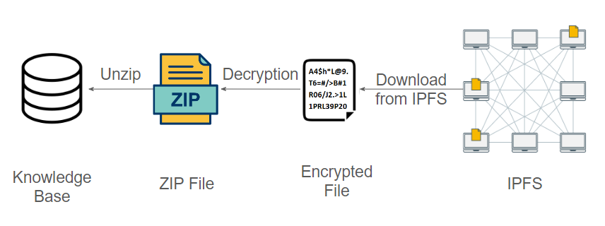
Implementation
Downloading from IPFS and Decryption
Decryption key same as encryption key which can only be generated by entering the right UserID and Password
Notes:
1. **Trust and Security:** Integrating blockchain with chatbots ensures heightened security for online transactions, addressing concerns about privacy and trust in digital interactions.
2. **Streamlined Convenience:** By harnessing chatbot capabilities, tasks spanning multiple platforms or apps can be efficiently managed through simple text prompts, enhancing convenience and reducing inconvenience.
3. **Expanded Potential:** The fusion of blockchain's security and chatbot versatility could exponentially broaden the applications of chatbots, offering a seamless and trustworthy user experience across various functionalities.

Slide 16
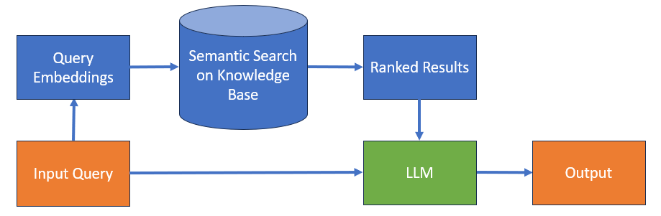
Implementation
Running LLM on Custom Files
Contains the embeddings and chunks from input documents arranges semantically
Same Chunking and Embedding strategies as used while processing the input documents
Notes:
1. **Trust and Security:** Integrating blockchain with chatbots ensures heightened security for online transactions, addressing concerns about privacy and trust in digital interactions.
2. **Streamlined Convenience:** By harnessing chatbot capabilities, tasks spanning multiple platforms or apps can be efficiently managed through simple text prompts, enhancing convenience and reducing inconvenience.
3. **Expanded Potential:** The fusion of blockchain's security and chatbot versatility could exponentially broaden the applications of chatbots, offering a seamless and trustworthy user experience across various functionalities.

Slide 17
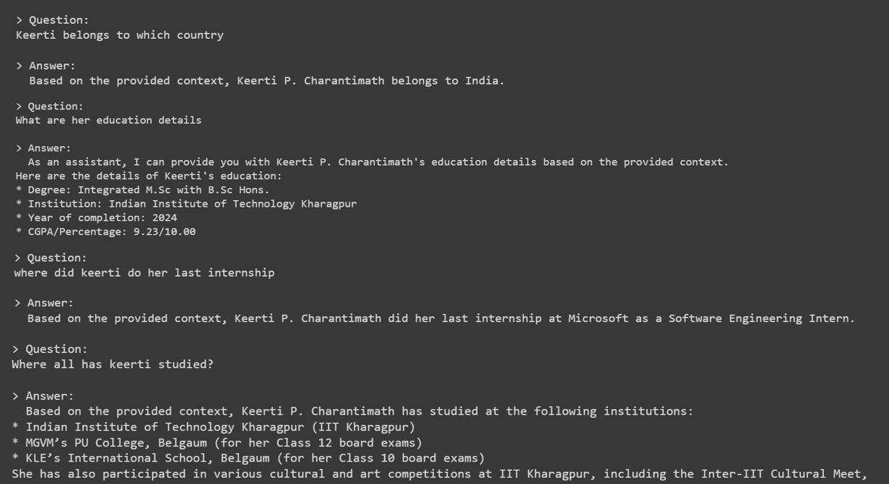
Results
LLM Answering questions based on my Resume

Slide 18
Thank You

